Slide 1
i-PROJECT PRESENTATION
PROJECT:- employee management system
GROUP members:-
Akash Samuel Khokhar
Chander Harwani
Ramsha Ansari
Romish Robert
Talha khan
Mentor:- ahsan ali naich
Center name:-Aptech Clifton Center

Slide 2
OBJECTIVES
Functional requirements:
Create employee record
Update employee record
Disable employee record
Mark employee time in and time out (none of the two can be repeated on specific day)
Calculate employee late comings in a month or among a range of two dates.
Assign leaves to employees among two specific dates (From and To) mark their as leave “L” within those dates.
See full monthly attendance report of each employee.

Slide 3
Problem Statement..
Software is created based on the following requirements…
Create employee record
Update employee record
Disable employee record
Mark employee time in and time out (none of the two can be repeated on specific day)
Calculate employee late comings in a month or among a range of two dates.
Assign leaves to employees among two specific dates (From and To) mark their as leave “L” within those dates.
See full monthly attendance report of each employee.

Slide 4
Timeline
Project Ref. No. |  | Project title | Date of Preparation
S.No | Task | E M P L O Y E E M A N A G E M E N T S Y S T E M | Activity Plan Prepared By: | Actual Start Date | Approx. End Date | Actual Days | Status
1 | Analysis |  | Chander Harwani, AKASH SAMUEL KHOKHAR | 18/01 | 20/01 | 3
2 | Data Collection |  | ALL OF THEM | 21/01 | 25/01 | 5
3 | Design |  | TALHA KHAN | 26/01 | 30/01 | 5
4 | Coding |  | CHANDER HARWANI, TALHA KHAN, Akash Samuel Khokhar | 1/02 | 29/02 | 29
5 | Databases |  | AKASH SAMUEL KHOKHAR | 28/01 | 30/01 | 3
6 | Documentation |  | RAMSHA ANSARI, ROMISH ROBERT | 25/02 | 27/02 | 3
7 | TESTING |  | ROMISH ROBERT, RAMSHA ANSARI | 27/02 | 28/02 | 2

Slide 5
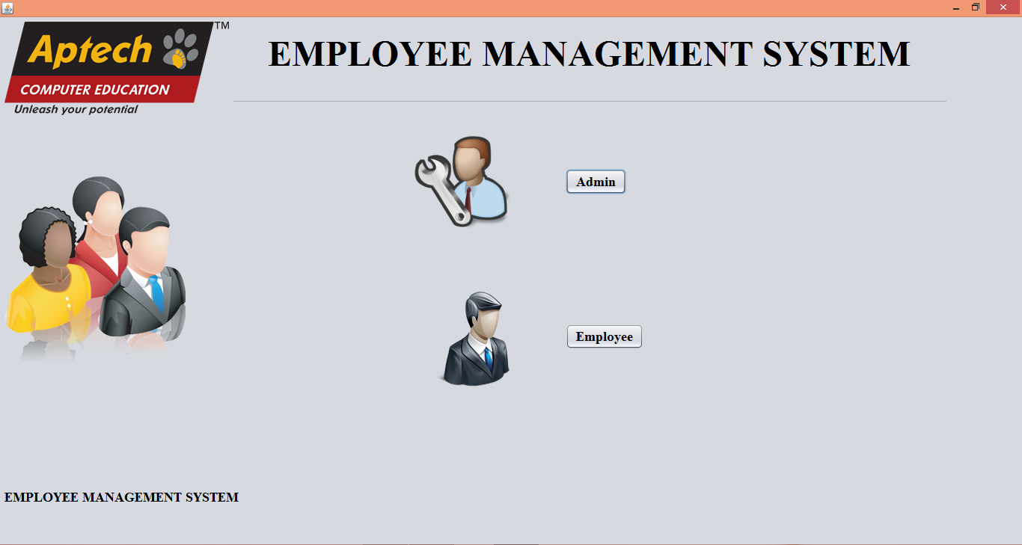
MAIN PAGE

Slide 6
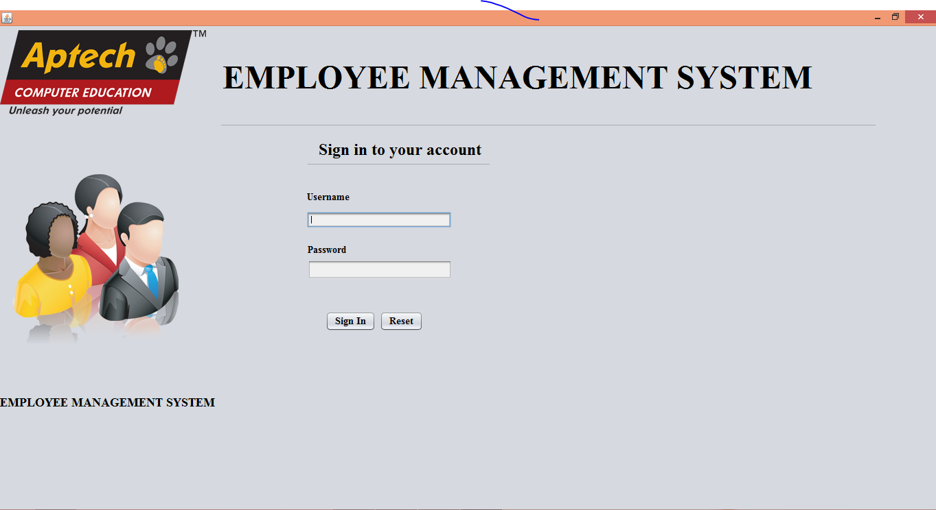
LOGIN FORM

Slide 7
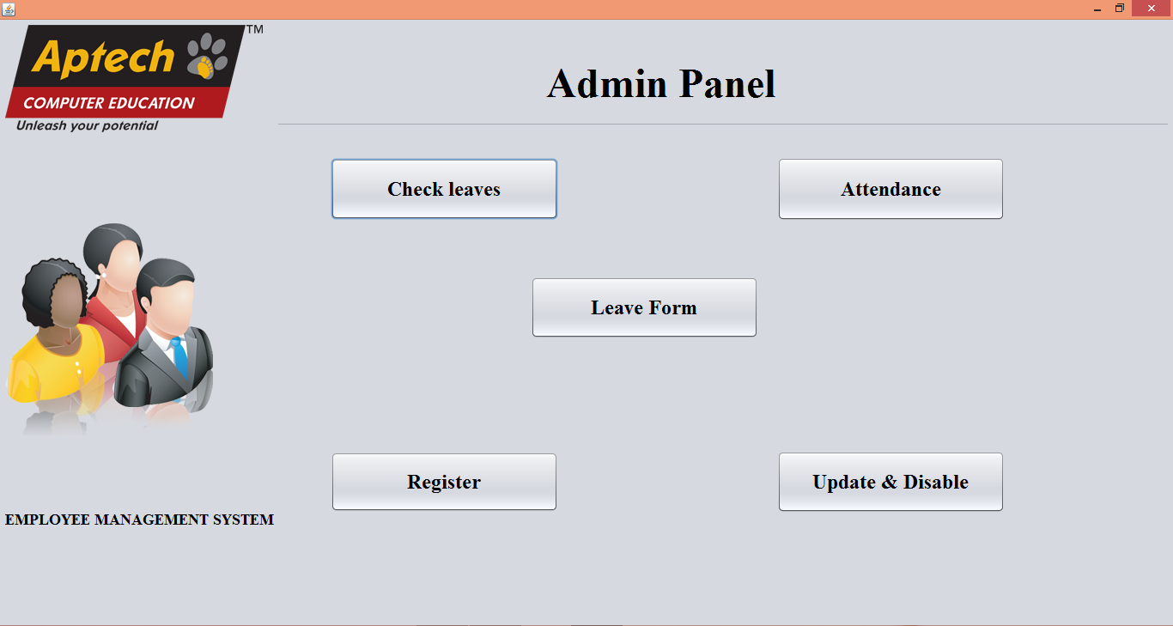
ADMIN PANEL

Slide 8
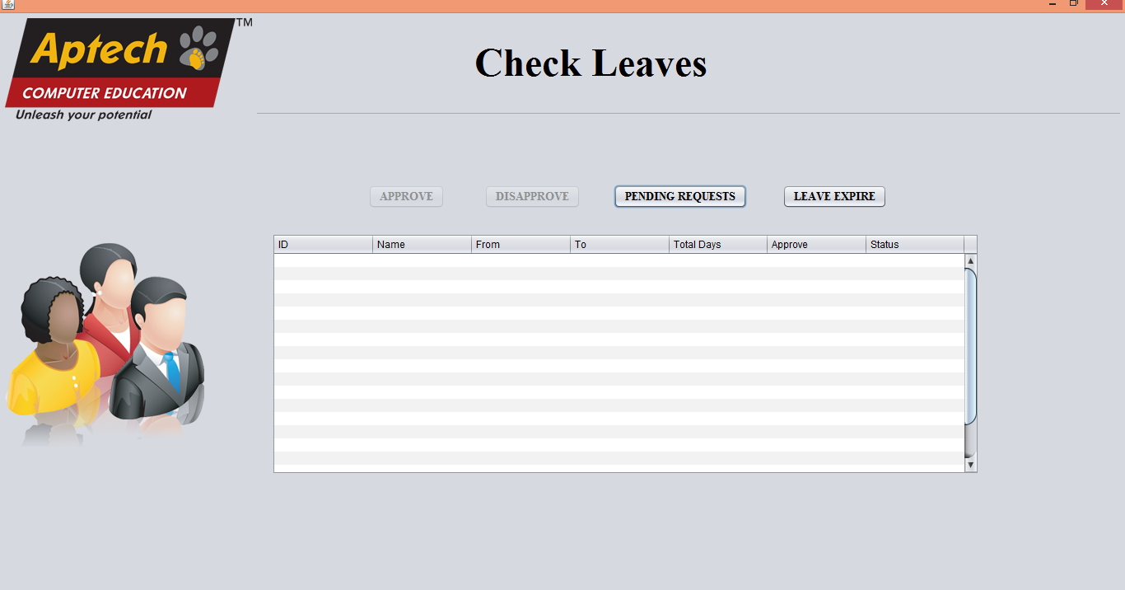
CHECK LEAVES

Slide 9
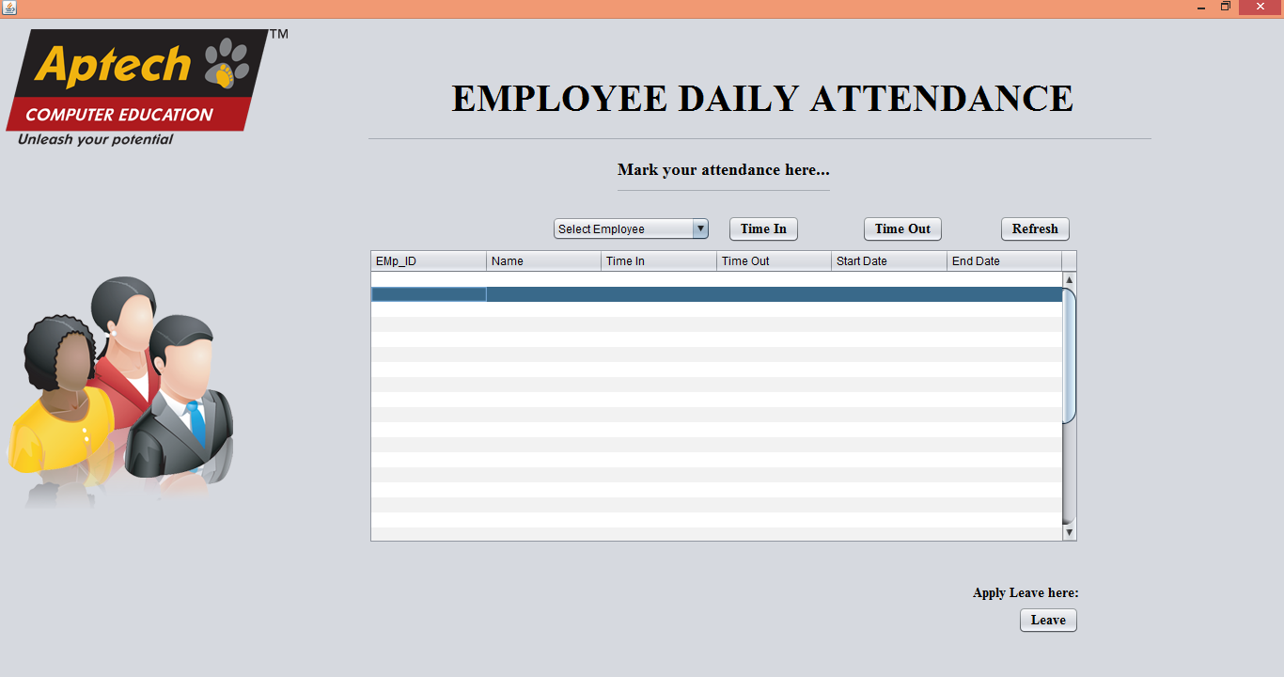
EMPLOYEE DAILY ATTENDANCE

Slide 10
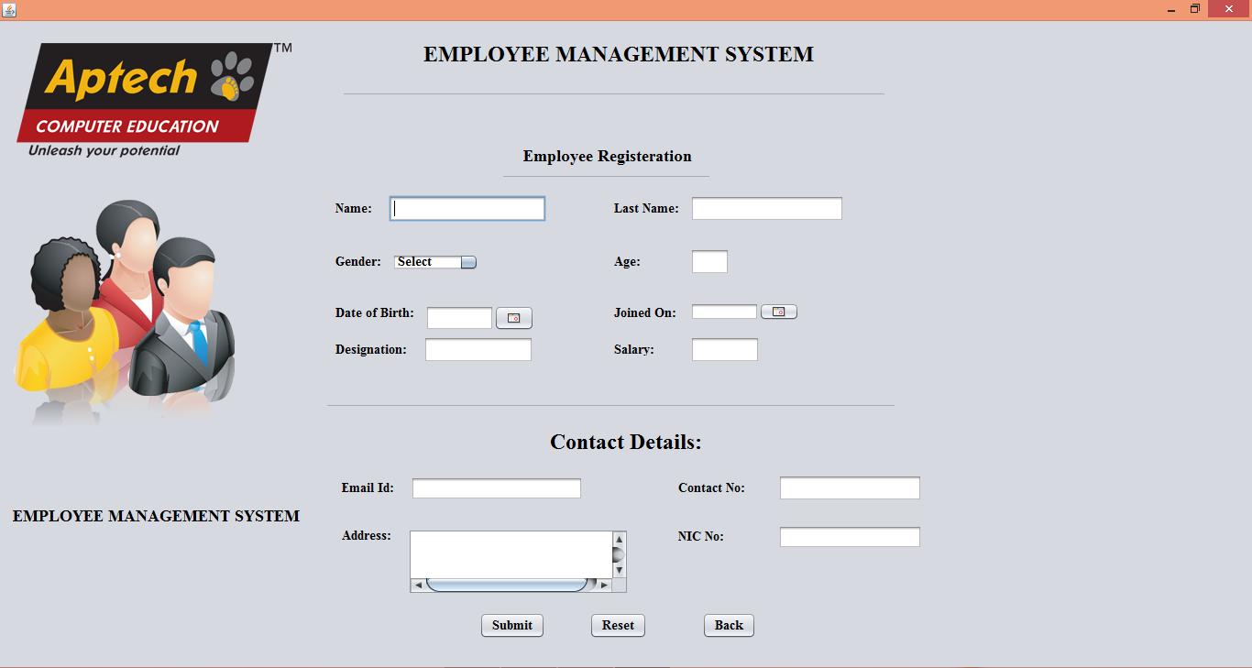
EMPLOYEE REGISTRATION

Slide 11
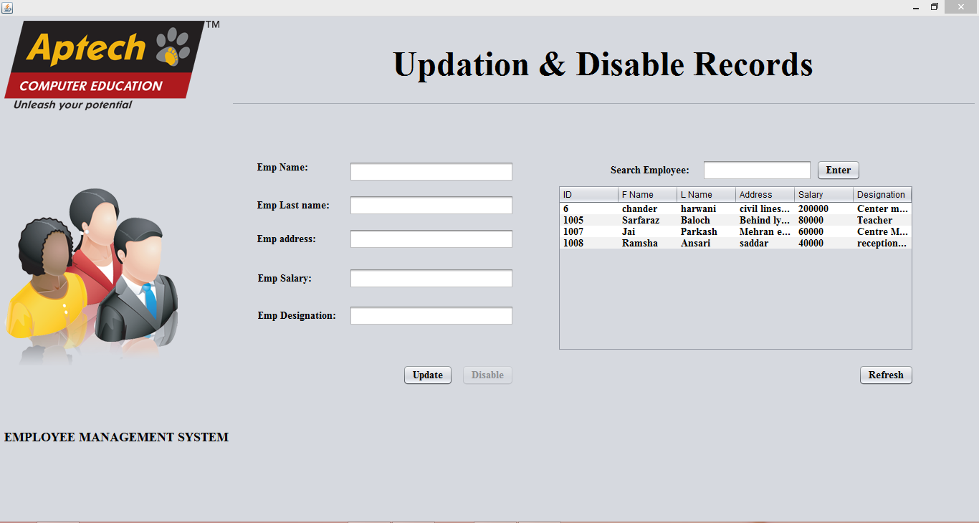
UPDATE & DISABLE RECORDS

Slide 12
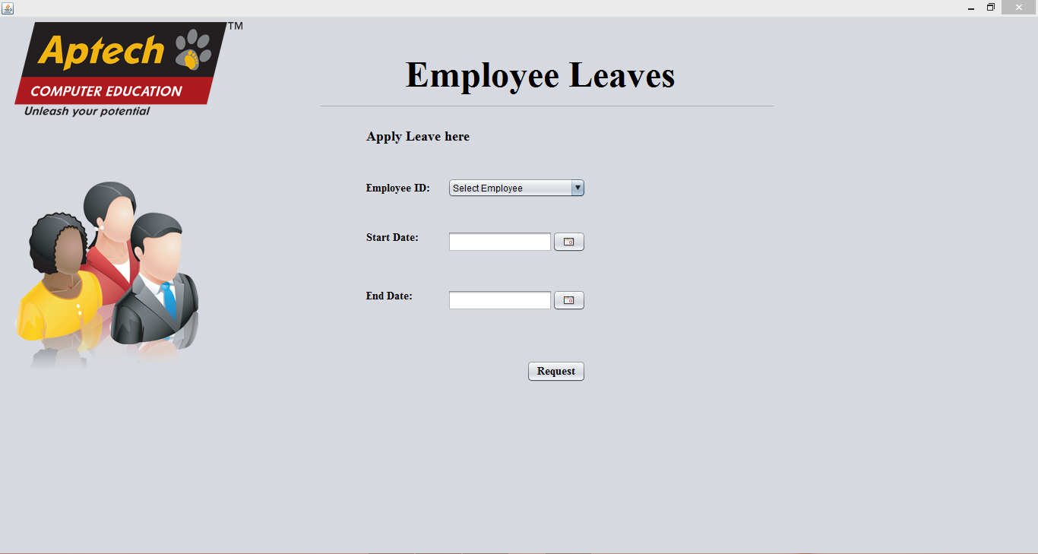
EMPLOYEE LEAVES

Slide 13

Thank You For Your Attention..
By Talha Khan, Ramsha Ansari, Romish Robert, Chander Harwani & Akash Samuel Khokhar.

